Slide 1
Statistical Learning for Classification
Tianhang Zheng
https://tianzheng4.github.io

Slide 2
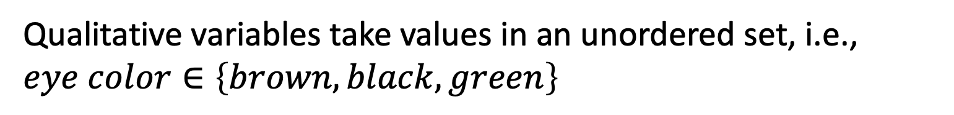
Quantitative vs Qualitative Outputs
Regression mainly study quantitative outputs
$$Y=β_{0}+β_{1}X_{1}+β_{2}X_{2}+…+β_{p}X_{p}+ε$$
Classification mainly study qualitative outputs
Qualitative variables take values in an unordered set, i.e.,
$$eye color∈\left\{brown, black, green\right\}$$

Slide 3



Why not Linear Regression
Binary Classification: $Y=\{0, 1\}$
$$\hat{y}={\hat{β}}_{0}+{\hat{β}}_{1}x$$
As long as ${\hat{β}}_{1}$ is not zero, the prediction could be larger than 1 or smaller than 0
Logistic regression is more appropriate!

Slide 4


Logistic Regression
$$p(Y=1|X)=\frac{e^{β_{0}+β_{1}X}}{1+e^{β_{0}+β_{1}X}}$$
$p\left(Y=1 | X\right)$ always has values between 0 and 1
$$\log\left(\frac{p}{1−p}\right)=β_{0}+β_{1}X$$

Slide 5
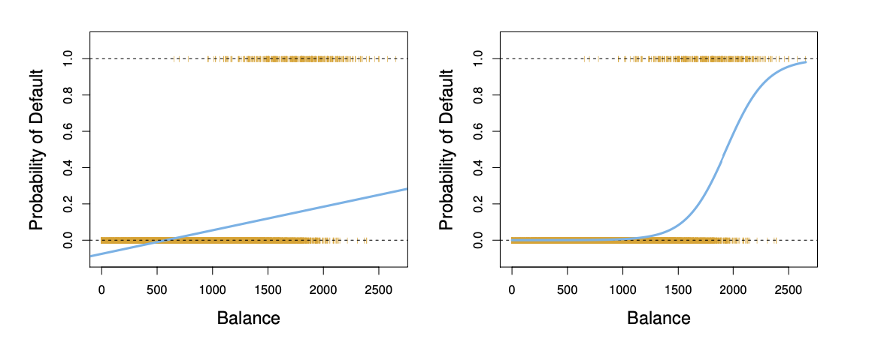
Linear Regression vs Logistic Regression

Slide 6

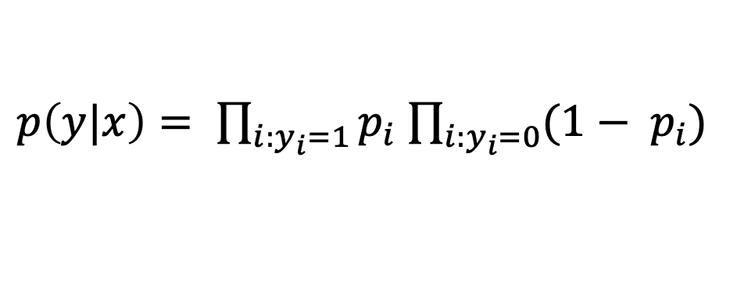
Maximum Likelihood Method
Commonly used for parameter estimation of logistic regression
Assume that the predictors are independent
$p\left(y|x\right)= \prod_{i:y_{i}=1}{p_{i}}$ $\prod_{i:y_{i}=0}{{(1− p}_{i})}$
$$p_{i}= p(y_{i}=1|x_{i})$$
This likelihood characterizes the conditional probability of the observed data

Slide 7
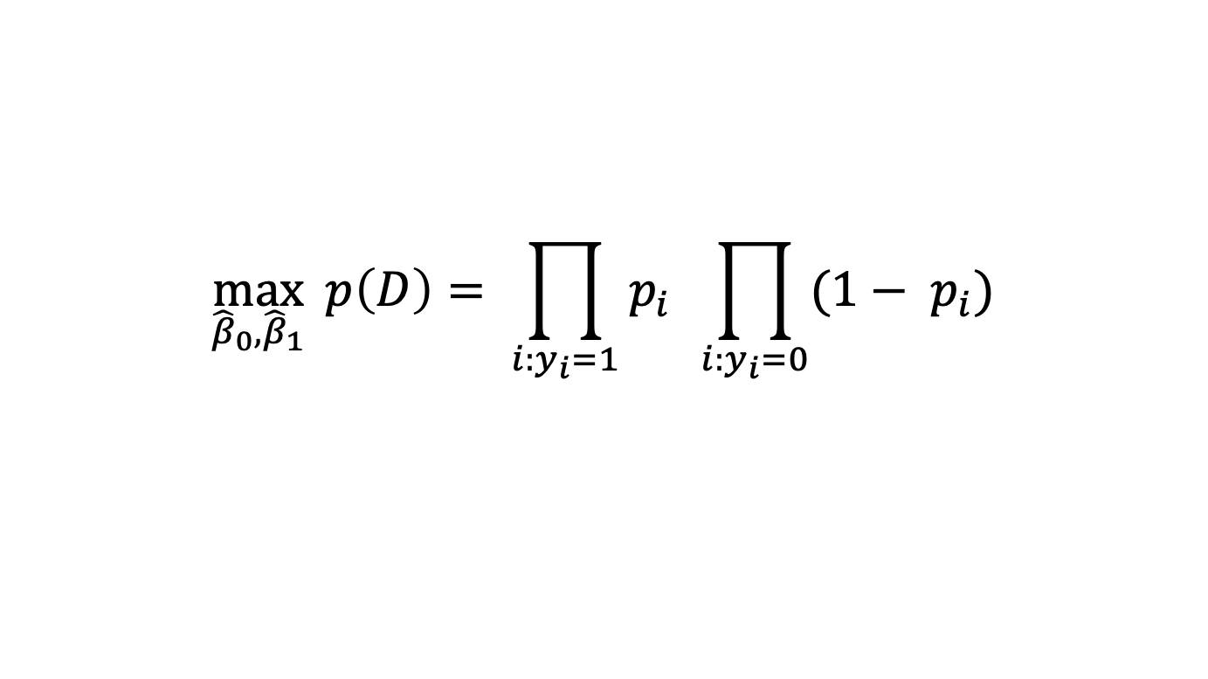
Maximum Likelihood Method
$$\max_{{\hat{β}}_{0},{\hat{β}}_{1}}{ p\left(D\right)= \prod_{i:y_{i}=1}{p_{i}} \prod_{i:y_{i}=0}{{(1− p}_{i})}}$$
May need to use an optimizer to solve the problem
In practice, we could use sklearn.linear_model.LogisticRegression

Slide 8

Multi-Class Logistic Regression
A linear function for each class
$$p(Y=k|X)=\frac{e^{β_{0k}+β_{1k}X}}{\sum_{l=1}^{K}{e^{β_{0l}+β_{1l}X}}}$$
Multi-class logistic regression is also called multinomial regression

Slide 9

Discriminant Analysis
Model the data distribution for each class as Gaussian distribution
Use the Bayes theorem to obtain $p(Y|X)$
$$p\left(Y=y | X=x\right)=\frac{p\left(X=x | Y=y\right)p(Y=y)}{p(X=x)}$$

Slide 10


Discriminant Analysis
$$p\left(Y=k | X=x\right)=\frac{p\left(X=x | Y=k\right)p(Y=k)}{p(X=x)}$$
Prior distribution: $π_{k}=p(Y=k)$
Data density for class k: $f_{k}(x)=p\left(X=x | Y=k\right)$
$$p\left(Y=k | X=x\right)=\frac{π_{k}f_{k}(x)}{\sum_{l=1}^{K}{π_{l}f_{l}(x)}}$$

Slide 11

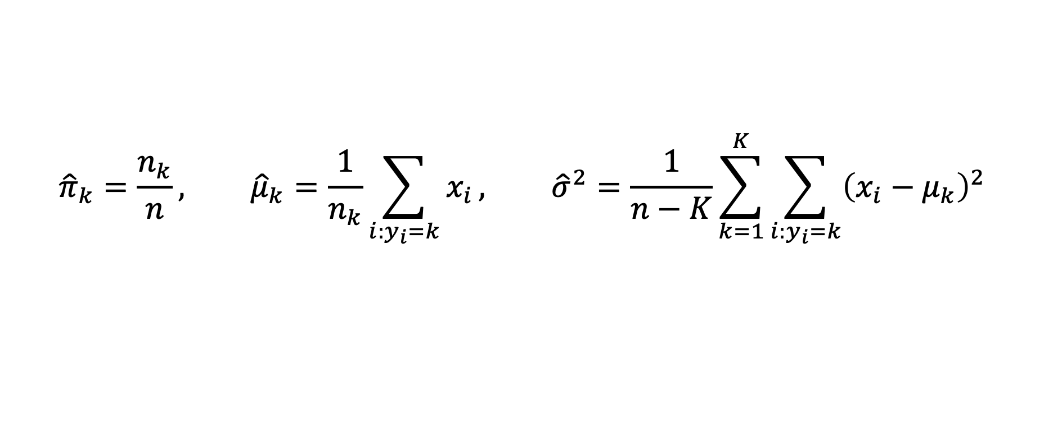
Discriminant Analysis
Model the data distribution for each class as Gaussian distribution
$$f_{k}(x)=\frac{1}{\sqrt{2πσ_{k}}}e^{−\frac{1}{2}{\left(\frac{x−μ_{k}}{σ_{k}}\right)}^{2}}$$
Use the data from class k to estimate the mean and standard deviation
$${\hat{π}}_{k}=\frac{n_{k}}{n}, {\hat{μ}}_{k}=\frac{1}{n_{k}}\sum_{i:y_{i}=k}{x_{i}}, {\hat{σ}}^{2}=\frac{1}{n−K}\sum_{k=1}^{K}{\sum_{i:y_{i}=k}{{\left(x_{i}−μ_{k}\right)}^{2}}}$$

Slide 12
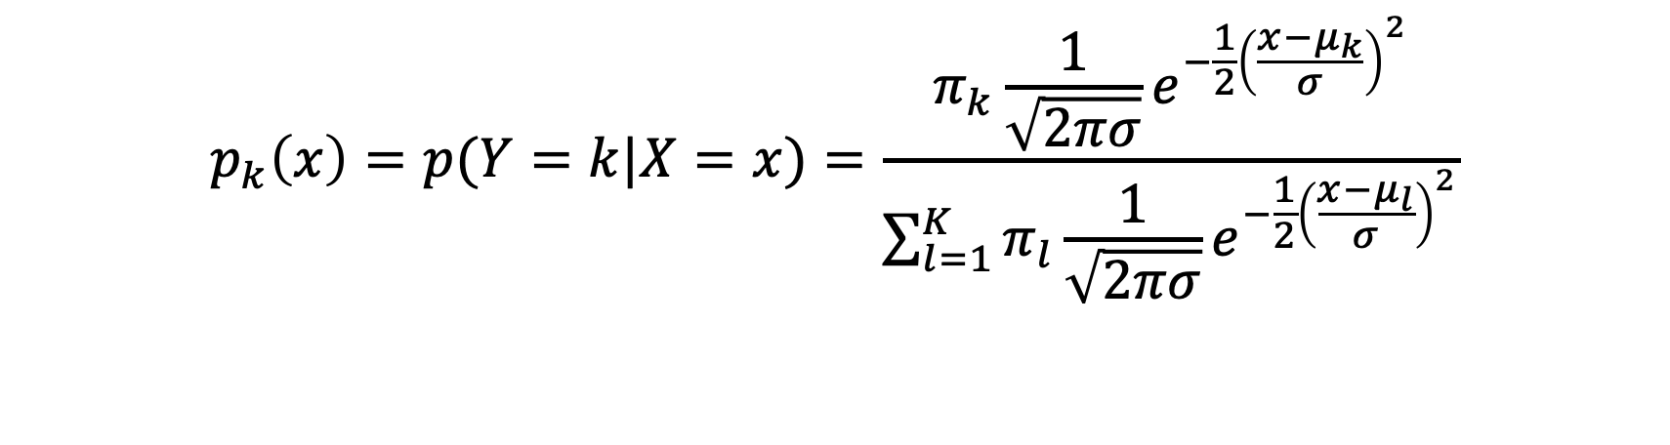
Discriminant Analysis
Classify $x$ as $k$ with the largest probability $p_{k}(x)$
$$p_{k}\left(x\right)=p(Y=k|X=x)=\frac{π_{k}\frac{1}{\sqrt{2πσ}}e^{−\frac{1}{2}{\left(\frac{x−μ_{k}}{σ}\right)}^{2}}}{\sum_{l=1}^{K}{π_{l}\frac{1}{\sqrt{2πσ}}e^{−\frac{1}{2}{\left(\frac{x−μ_{l}}{σ}\right)}^{2}}}}$$
Discriminant score
$$δ_{k}\left(x\right)=x\frac{μ_{k}}{σ^{2}}−\frac{μ_{k}^{2}}{{2σ}^{2}}+log⁡(π_{k})$$

Slide 13
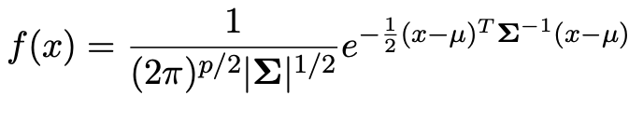
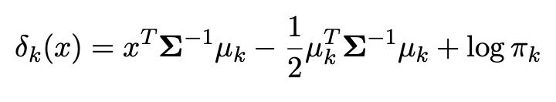
Multi-Variable Discriminant Analysis
Use the data from class k to estimate the mean and covariance

Slide 14
Linear or Quadratic Discriminant Analysis
Linear Discriminant Analysis: same estimation of standard deviation or covariance for all the classes
Quadratic Discriminant Analysis: different estimations of standard deviation or covariance for all the classes

Slide 15
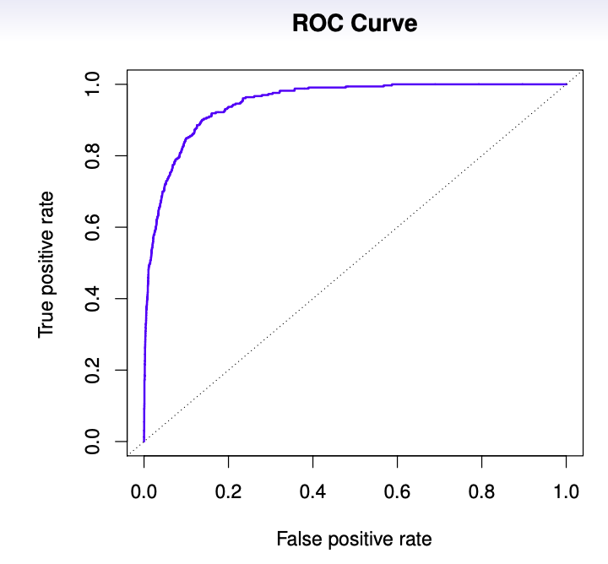
ROC Curve
True Positive Rate and False Positive Rate
$$p\left(Y=1 | X\right)≥threshold$$

Slide 16
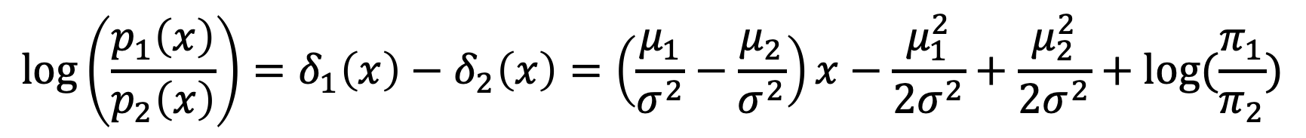
Logistic Regression vs Linear DA
Linear Discriminant Analysis
$$\log\left(\frac{p_{1}\left(x\right)}{p_{2}\left(x\right)}\right)=δ_{1}\left(x\right)−δ_{2}\left(x\right)=\left(\frac{μ_{1}}{σ^{2}}−\frac{μ_{2}}{σ^{2}}\right)x−\frac{μ_{1}^{2}}{{2σ}^{2}}+\frac{μ_{2}^{2}}{{2σ}^{2}}+log⁡(\frac{π_{1}}{π_{2}})$$
Logistic Regression maximizes conditional likelihood for estimation (discriminative learning)
Linear Discriminant Analysis use full likelihood (generative learning)

Slide 17

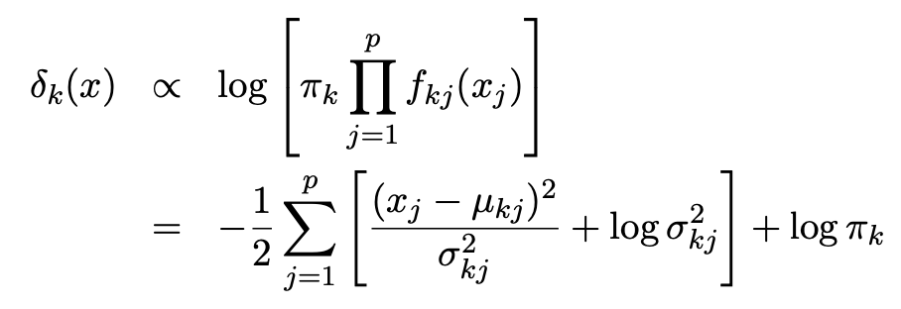
Naïve Bayes
Assume the features are independent, which means the covariance matrix is diagonal.
Discriminant score

Slide 18
K Nearest Neighbors
A non-parametric supervised learning algorithm for classification
Assign the label of x based on a majority vote mechanism
Select the k training points that are nearest to the target point x
Assign the majority label for the k training points as the label of x

Slide 19
Grid Search for k
To search the best k, we could create a validation dataset
Try different k, and see the performance on the validation dataset
Select the best-performed k (can be done by sklearn)

Slide 20
Summary
Logistic Regression is very popular when K=2
Linear Discriminant Analysis is useful when n is small, K is large and the Gaussian distribution assumption makes sense
Naïve Bayes is useful when p (number of features) is large, and features are not correlated

Slide 21
Q & A

